Slide 1

What have we done so far?

Slide 2
Research
Researched about SEN Users

Slide 3
Requirements
Determined basic Requirements from the research

Slide 4
Stakeholder Interviews
Did interviews with qualified professionals

Slide 5
Client Meeting
Hai-Van Client meeting

Slide 6
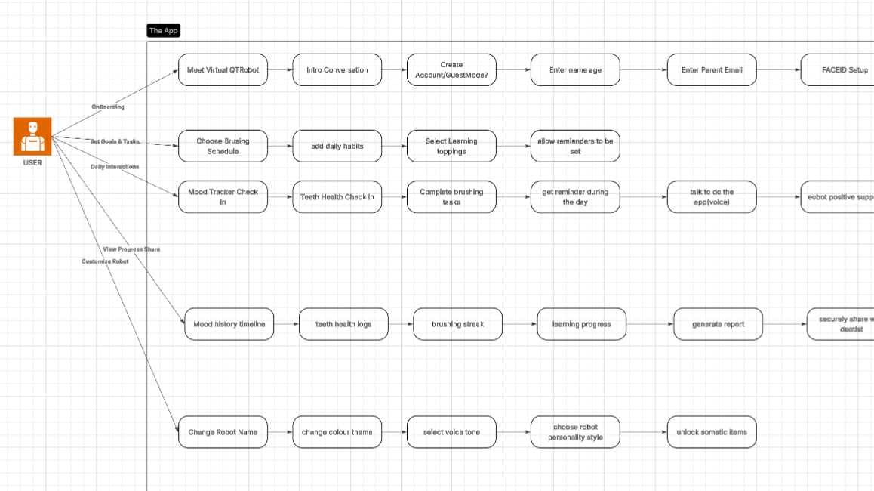
Use case Diagram

Slide 7
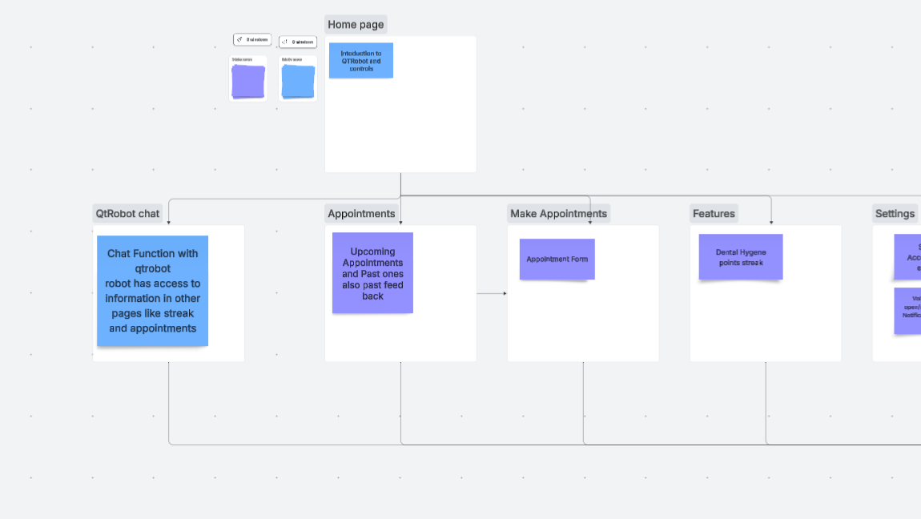
Flow Diagrams

Slide 8
Initial ERD

